Slide 1
Bayesian inference using MCMC in Stan
CSTAT Workshop
March 2021
Juan P. Steibel

Slide 2
Workshop schedule
Intro to Bayesian
MCMC and Convergence diagnostics
Gaussian Linear models
R-stan practice 1: a first stan program. Regression
R-stan practice 2: Effect of prior. Regression
R-stan practice 3: predictive checks. Regression
R-stan practice 4: classification effects models
R-stan practice 5: stanarm and model checking in linear models.
Poisson Generalized Linear Models
R-stan practice 6: Poisson GLM, overdispersion, model checking
Repeated measures
R-stan practice 7: random coefficient models

Slide 3
Course description
Course objective: To train students in Bayesian inference and its implementation through Monte Carlo methods with application to current problems in biological data analysis.
Course implementation: 2 hours of recitation and 2 hours of computer lab (2+2)

Slide 4
Intro to probability
Events
Sample space
Ω
B
0 ≤ P(A) ≤ 1
0 ≤ P(B) ≤ 1
P(Ω) =1
P(φ) =0
A

Slide 5
Joint probability
Event
P(A ∩B)
Sample space
Ω
B
0 ≤ P(A) ≤ 1
P(Ω) =1
P(φ) =0
A

Slide 6
Conditional probability
Ω
B
A
P(A ∩B)
P(A|B)=
P(B)

Slide 7
Conditional probability
This is now the sample space
B
P(B)=1
A
This is the event
P(A ∩B)
P(A ∩B)
P(A|B)=
P(B)

Slide 8
Bayes’ Rule
P(A ∩B)
P(A ∩B)
P(A|B)=
P(B|A)=
P(B)
P(A)
P(A ∩ B) = P(B) P(A|B) = P(B|A) P(A)
Throughout this course we’ll use this identity pervasively (hence its name!)
Now observe this:
P(B|A) P(A)
P(A|B) =
P(A|B) ∝ P(B|A) P(A)
P(B)

Slide 9
Bayes’ rule and Bayesian inference
A: θ, parameters, B: y, data:
Posterior
Prior
Likelihood

Slide 10
The Likelihood
Sampling distribution of the data viewed as a function of parameters θ
Pervasively used in frequentist inference

Slide 11
Maximum likelihood inference
The likelihood function is any function L(θ|y) of θ proportional to p(y|θ)

Slide 12
The prior
Reflects the current state of knowledge about a parameter using a probability density function
It is a distinctive and controversial element of Bayesian inference
It is usually subjectively specified
A proper prior: true PDF
An improper prior: not a PDF (a positive function, but it does not integrate to 1)

Slide 13
The posterior
Reflects the updated state of knowledge about a parameter using a probability density function
It has to be proper, if it is not, the results are not valid
Will become prior in further studies

Slide 14
Prior HAS TO BE independent of Likelihood
Otherwise, we can’t use Bayes’ rule and just multiply them to obtain the posterior!
This precludes the researcher from using the data to define a prior!
Yes, “peaking at your data” is also not allowe ☺

Slide 15
Prior and its influence
Posterior density depends on likelihood and prior
Bayesian inference is subjective.
We could attempt to use a “non-informative” prior, example:
But if this is an improper distribution, the posterior MAY be improper.
It may also be inefficient and counterintuitive

Slide 16
What to do?
Choose a prior that reflects your prior knowledge. Think hard!
Choose an automatic prior (not recommended, but necessary sometimes)
Choose a set of priors and check sensitivity of results (best)
Update your knowledge! (see naïve example: good in theory, not too practical)

Slide 17
Example
H
Hh
Hh?
HH?
Prior:
h
H
H

Slide 18
Example
H
Hh
Hh?
HH?
h
We can start over again!
H
H
H

Slide 19
Bayesian Learning!
H
Hh
We can treat the posterior derived from the first two progeny as a prior and use the progeny from the third progeny to obtain an (updated) posterior:
Hh?
HH?
h
H
H
H

Slide 20
Bayesian learning
We represent our current knowledge of nature with a prior distribution
We collect data and build a likelihood
Bayes’ rule allows us updating the prior knowledge with current evidence to create the posterior
We keep updating with new data
=We learn

Slide 21
But…
My brother had the disease
The whole trick is to come up with a prior here.
A good prior could be P(θ)=0
Another one could be based on epidemiological data (serious?)
Or based on more distant relatives?
H
?
p(Hh)=0.5
p(HH)=0.5
p(Hh)=0.25
p(HH)=0.75
Hh?
HH?
These are subjective priors
that no one would object to ☺
H
H
H

Slide 22
Suppose you can elicit your prior and obtain the posterior… What is next?

Slide 23
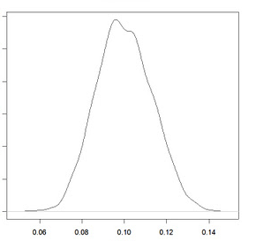
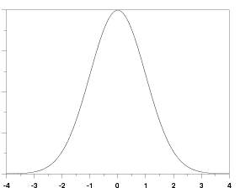
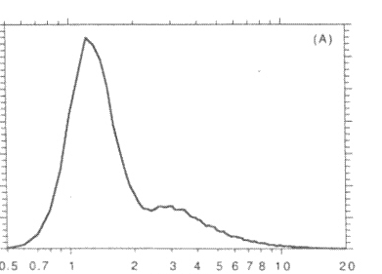
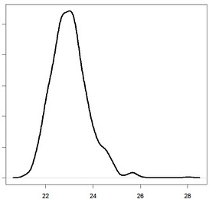
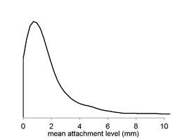
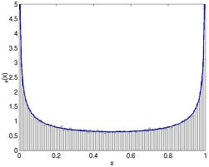
Summarizing the Posterior Distribution
The posterior is a (whole distribution)
How do we summarize it?

Slide 24
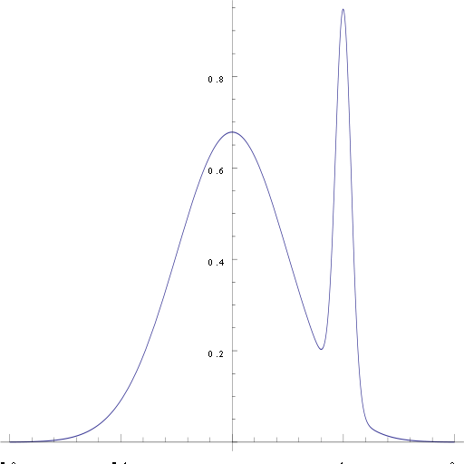
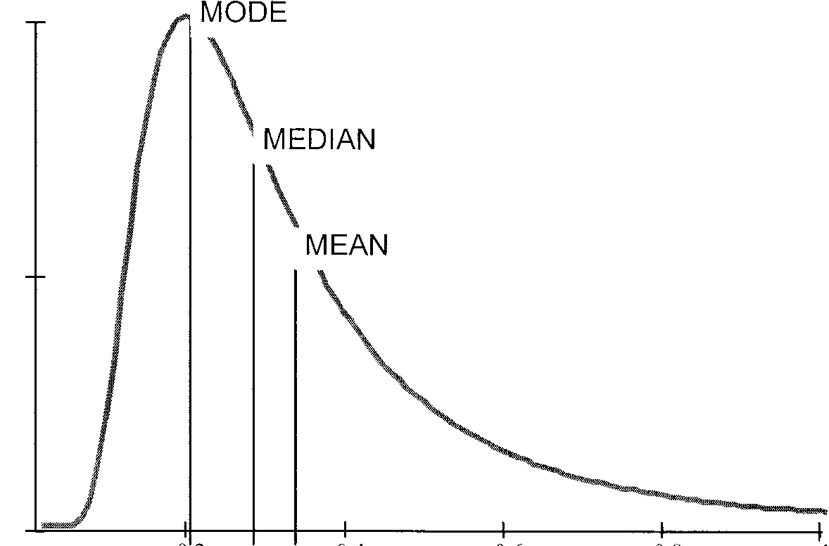
Point Estimation: Which one?
Symmetry of posterior? Number of modes?

Slide 25
Point Estimation
Mean? Median? Mode?
Justification related to decision theory
Mode: All/nothing loss function
Median: Absolute difference loss function
Loss proportional to absolute “error of estimation”
Mean: Quadratic loss function
Loss proportional to the square of the error
Expected value

Slide 26
Interval Estimation
Credible set or Credibility interval
Bayesian “Confidence Interval”
Interval of posterior probability 100(1-α)%
C = Subset of the parameter space for θ
Direct probability statement about the likelihood of θ falling inside C, given the data
… infinite number of possible intervals

Slide 27
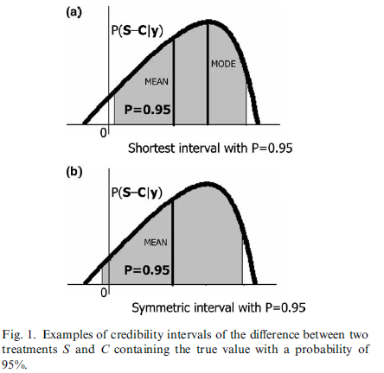
Interval Estimation
Questions:
What is the difference btw Trt?
What is the precision of the estimated difference?
Blasco 2005, Meat Science

Slide 28
Interval Estimation
Bayesian
95% credibility interval: an interval in the domain of the posterior distribution where the true parameter will lie with 95% probability.
Extremes are FIXED and conditional on data. Parameter is random and it may lie within the interval or not with probability 95%.
Frequentist
95% confidence interval: an interval of random extremes that if we were to repeat the experiment MANY times, it would contain the parameter with probability 95%
Extremes are random, parameter is fixed. Probability that a CI (95%) contains true parameter is unknown and it is 0 or 1.

Slide 29
Hypothesis Testing
Classical approach bases reject/fail-to-reject decision on:
where “extremeness” is in the direction of H1
Problems with this approach
Hypotheses must be nested
H0 testing is asymmetric → P-value can only offer evidence against H0
P-value is NOT the “probability that H0 is true”
P-value has no direct interpretation as “weight of the evidence” → Only long-term probability

Slide 30
Bayesian Hypothesis testing
It also resorts to comparing models, but they not need to be nested.
Models are treated as unknown, and they are assigned a prior.
It uses a Bayes Factor and posterior model probabilities to compare models.
Because model is unknown (is treated as a random variable random), it can be integrated out of inferences
We will not learn this in this workshop… maybe in the next one?

Slide 31
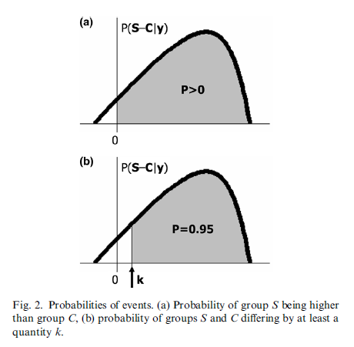
Alternative Posterior Inference…
Questions:
What is the probability that Trt S yields a greater response than Control?
How large can we say is the Trt difference with a probability of 95%?
Posterior densities
Blasco 2005, Meat Science

Slide 32
What we’ve learned today
Basic probability rules
Bayes’ Rule
Probability distribution (self-study)
Concept of Likelihood (freq.) inference
Concept of Bayesian Inference
Where does MCMC fits in
Bayesian vs Frequentist inference
Computational tools

